Slide 1
DEPARTMENT OF ELECTRICAL AND ELECTRONICS ENGINEERING
18EEP301L-MINOR PROJECT – III
TEMPERATURE CONTROLLED FAN
YEAR/ SEMESTER – III/V
BATCH NUMBER :15
GUIDED BY:
Mr .S. DINESHKUMAR M.E., AP/EEE
PRESENTED BY:
POORVASANDHYA.P(927622BEE081)
PRAVEEN.M(927622BEE307)
SHARANYA.P(927622BEE105)
SRINITHI.K(927622BEE115)

Slide 2
LIST OF CONTENTS
Abstract
Objective
Problem Description
Existing system
Proposed system
Components used

Slide 3
ABSTRACT
This project designs an intelligent fan system that adjusts speed based on ambient temperature, optimizing energy efficiency and comfort.
Using a temperature sensor and pulse-width modulation, the fan automatically turns on/off and changes speed to maintain a set temperature, reducing noise and energy consumption.
The system is designed to optimize energy efficiency, reduce noise pollution, and provide a comfortable environment.

Slide 4

The objective of this project is to design and develop an intelligent temperature-controlled fan system that automatically adjusts its speed according to the ambient temperature, thereby maintaining a comfortable environment while minimizing energy consumption.
The system aims to provide a cost-effective, efficient, and user-friendly solution for temperature control, with the potential for integration into smart home systems for enhanced convenience and remote monitoring capabilities.

Slide 5
PROBLEM DESCRIPTION
Traditional fans operate at a fixed speed, regardless of the ambient temperature, resulting in inefficient energy consumption, uncomfortable temperature fluctuations, and noise pollution.
Manual adjustments are required to turn the fan on/off or adjust its speed, causing inconvenience and neglect.
This leads to a significant need for an intelligent temperature-controlled fan system that can automatically adjust its speed according to the ambient temperature, providing a comfortable environment while minimizing energy consumption.

Slide 6
EXISTING SYSTEM
The existing fan systems are manual or fixed-speed, requiring users to physically
turn the fan on/off or adjust its speed using a switch or knob, without real-time
temperature monitoring or automatic speed adjustment.
This results in inefficient energy consumption, uncomfortable temperature
fluctuations, and noise pollution, while also requiring manual intervention for
speed adjustment and lacking remote monitoring or control capabilities,
highlighting the need for a more intelligent and automated solution.

Slide 7
PROPOSED SYSTEM
The proposed system is an intelligent temperature-controlled fan system that
automatically adjusts its speed based on real-time ambient temperature readings,
utilizing temperature sensors, a microcontroller-based control unit, and pulse-
width modulation (PWM) for precise fan speed control.
This system offers remote monitoring and control capabilities through smart home
integration, ensuring energy-efficient operation with optimized fan speed, and
providing a comfortable environment while minimizing energy consumption,
noise pollution, and manual intervention.

Slide 8
COMPONENTS USED
Temperature sensor(DHT11)
Microcontroller (e.g. Arduino, ESP32)
Fan Motor
Power Supply
Smart Home Module (e.g. Wi-Fi, Bluetooth)
Wiring and Connectors

Slide 9
TEMPERATURE SENSOR
The DHT11 is a widely used temperature and humidity sensor known for its accuracy, reliability, and ease of use.
This digital sensor measures temperature in the range of 0-50°C with an accuracy of ±2°C and humidity in the range of 20-90% with an accuracy of ±5%.
The DHT11 features a simple one-wire protocol, making it easy to integrate with microcontrollers like Arduino and Raspberry Pi.
With low power consumption and a fast response time of 1 second, the DHT11 is suitable for various applications, including weather stations, home automation, and IoT projects.
Its compact design and affordable price make it a popular choice among hobbyists and professionals alike

Slide 10
ARDUINO UNO
The Arduino Uno is a microcontroller board and the most popular member of the Arduino family.
It's a compact, versatile, and easy-to-use platform that enables users to create a wide range of interactive projects.
The Uno features 14 digital input/output pins, 6 analog inputs, and a USB connection for programming.
Powered by an ATmega328P microcontroller, it operates at 5V and has a clock speed of 16 MHz.
The Uno's simplicity and affordability make it an ideal choice for beginners, while its advanced features and compatibility with various shields and libraries appeal to experienced makers.

Slide 11
12 VOLT DC CONTROLLED FAN
A 12V DC fan is a type of electric fan that operates on a direct current (DC) power supply of 12 volts.
These fans are widely used in various applications, including computers, electronic devices, and automotive systems, due to their compact size, low power consumption, and high airflow efficiency.
12V DC fans typically feature a brushless motor design, which provides reliable operation, reduced noise, and increased lifespan.
They are often equipped with a 2-pin or 3-pin connector for easy installation and may include additional features such as PWM (Pulse Width Modulation) control for variable speed adjustment

Slide 12
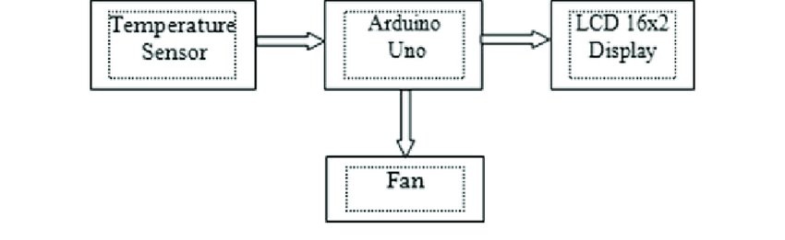
BLOCK DIAGRAM

Slide 13
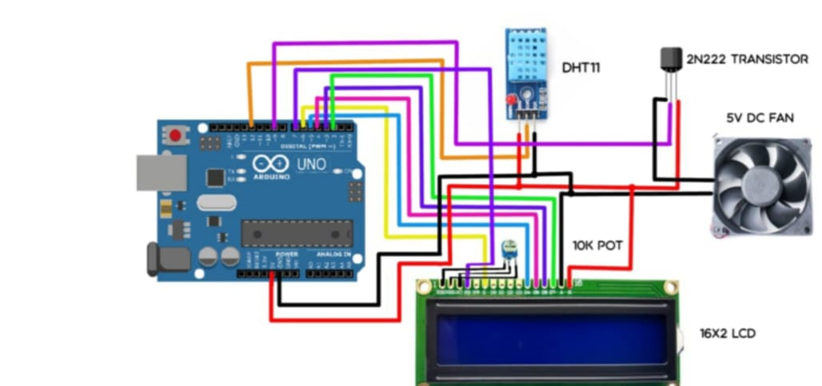
CIRCUIT DIAGRAM

Slide 14
FUTURE SCOPES
Temperature-controlled fans have significant future potential across various sectors. It includes
Smart home integration for automated climate control.
Enhanced energy efficiency through advanced sensors.
Health applications in healthcare settings.

Slide 15
They can optimize conditions in agriculture.
It improve passenger comfort in vehicles, and adapt to extreme weather for climate resilience.
The development of eco-friendly materials and the incorporation of IoT technology for data analytics can further enhance their functionality.
It making them a versatile solution for comfort, efficiency, and sustainability in diverse environments.

Slide 16
WORKING
Temperature-controlled fans operate by using sensors to monitor ambient temperature and humidity.
When the temperature exceeds a predetermined threshold, the fan activates, adjusting its speed to regulate airflow and maintain a comfortable environment.
This process typically involves:
Sensors: Temperature and humidity sensors detect changes in the environment.
Controller: A microcontroller processes the sensor data and determines when to activate the fan and at what speed.

Slide 17
3.Motor: The fan motor adjusts its speed based on the controller's signals, increasing airflow when needed and slowing down as conditions improve.
4.Feedback Loop: Continuous monitoring allows the system to make real-time adjustments, ensuring optimal comfort and energy efficiency.

Slide 18
COST ESTIMATION
COMPONENTS | COST
TEMPERATURE SENSOR | Rs.180
ARDUINO | Rs.700
MOTOR | Rs.400
12 VOLT DC FAN | Rs.200
TOTAL | Rs.1480

